Slide 1
MARKET-BASED VALUATION: PRICE MULTIPLES

Slide 2
Introduction
Price multiples are ratios of a stock’s market price to some measure of value per share. A price multiple summarizes in a single number a valuation relationship to a familiar quantity such as earnings, sales, or book value per share.
Momentum indicators relate either price or a fundamental (such as earnings) to the time series of their own past values, or in some cases to their expected value.

Slide 3
Method of comparables
The method of comparables involves using a price multiple to evaluate whether an asset is relatively fairly valued, relatively undervalued, or relatively overvalued in relation to a benchmark value of the multiple.
Choices for the benchmark value of a multiple include the multiple of a closely matched individual stock and the average or median value of the multiple for the stock’s peer group of companies or industry.

Slide 4
Method of comparables
The economic rationale underlying the method of comparables is the law of one price—the economic principle that two identical assets should sell at the same price.
  The method of comparables is perhaps the most widely used approach for analysts reporting valuation judgments on the basis of price multiples.
If we find that an asset is undervalued relative to a comparison asset or group of assets, we may expect the asset to outperform the comparison asset or assets on a relative basis.
  However, if the comparison asset or assets themselves are not efficiently priced, the stock may not be undervalued—it could be fairly valued or even overvalued (on an absolute basis).

Slide 5
Method based on forecasted fundamentals
A price multiple can be related to fundamentals through a DCF model.
  An example: Earlier we explained the price–earnings ratio in terms of perhaps the simplest DCF model, the Gordon growth dividend discount model.

Slide 6
Justified price multiple
A justified price multiple for the stock is the estimated fair value of that multiple.
We can justify a multiple based on the method of comparables or the method based on forecasted fundamentals.
The justified price multiple is also called the warranted price multiple or the intrinsic price multiple.

Slide 7
The price/earnings approach
In the first edition of Security Analysis, Benjamin Graham and David L. Dodd (1934) described common stock valuation based on price–earnings ratios as the standard method of that era.
  The price–earnings (P/E) ratio is still the most familiar valuation measure today.
Our discussion:
  rationales offered by analysts for its use, as well as possible drawbacks.
  two chief variations of the P/E, the trailing P/E and the leading P/E.
  Accounting issues: Market price is definitely determinable and presents no special problems of interpretation. However, the denominator, earnings per share, is based on the complex rules of accrual accounting and does present important issues of interpretation. There are several accounting issues, as well as adjustments analysts can make to obtain more meaningful price–earnings ratios.

Slide 8
Rationales for the use of P/E ratios
Earning power is a chief driver of investment value. Earnings per share (EPS), the denominator of the price–earnings ratio, is perhaps the chief focus of security analysts’ attention.
The price–earnings ratio is widely recognized and used by investors.
Differences in price–earnings ratios may be related to differences in long-run average returns, according to empirical research.

Slide 9
Drawbacks to P/E ratios
Drawbacks based on nature of EPS.
EPS can be negative. The P/E ratio does not make economic sense with a negative denominator.
The components of earnings that are on-going or recurrent are most important in determining intrinsic value. However, earnings often have volatile, transient components, making the analyst’s task difficult.
Management can exercise its discretion within allowable accounting practices to distort earnings per share as an accurate reflection of economic performance. Distortions can affect the comparability of P/E ratios across companies.

Slide 10
Accounting issues with P/E ratios
In calculating a P/E ratio, the current price for publicly traded companies is generally easily obtained and unambiguous.
Determining the earnings figure to be used in the denominator, however, is not as straightforward. Two issues are
  the time horizon over which earnings are measured, which results in two chief alternative definitions of the price–earnings ratio; and
  adjustments to accounting earnings that the analyst may make so that P/Es are comparable across companies.

Slide 11
Trailing and leading P/E’s
The two chief definitions of P/E are trailing P/E and leading P/E.
The trailing P/E (sometimes referred to as current P/E) of a stock is the current market price of the stock divided by the most recent four quarters’ earnings per share. The EPS in such calculations are sometimes referred to as trailing twelve months (TTM) EPS. Trailing P/E is the price–earnings ratio published in stock listings of financial newspapers.
The leading P/E (also called the forward P/E or the prospective P/E) is calculated by dividing the current price by next year’s expected earnings.
First Call/Thomson Financial reports as the “current P/E” market price divided by the last reported annual earnings per share. Value Line reports as the “P/E” market price divided by the sum of the preceding two quarters’ trailing earnings and the next two quarters’ expected earnings.

Slide 12
Issues with trailing P/E’s
When calculating a P/E ratio using trailing earnings, care must be taken in determining the EPS number. The issues include
transitory, nonrecurring components of earnings that are company-specific;
transitory components of earnings due to cyclicality (business or industry cyclicality);
differences in accounting methods; and
potential dilution of earnings per share.

Slide 13
Cyclicality of P/E’s
Because of cyclic effects, the most recent four quarters of earnings may not accurately reflect the average or long-term earnings power of the business, particularly for cyclical businesses—businesses with high sensitivity to business or industry cycle influences. Trailing earnings per share for such stocks are often depressed or negative at the bottom of the cycle and unusually high at the top of the cycle.
Empirically, P/Es for cyclical companies are often highly volatile over a cycle without any change in business prospects: high P/Es on depressed EPS at the bottom of the cycle and low P/Es on unusually high EPS at the top of the cycle, a countercyclical property of P/Es known as the Molodovsky effect. Named after Nicholas Molodovsky who wrote on this in the 1950s. P/Es may be negatively related to the recent earnings growth rate but positively related to anticipated future growth rate, because of expected rebounds in earnings.

Slide 14
Normalized P/E’s
Nomalized EPS can be used to create a normalized P/E. Two methods for nomalizing EPS?
The method of historical average EPS. Normal EPS is calculated as average EPS over the most recent full cycle.
The method of average ROE. Normal EPS is calculated as the average return on equity from the most recent full cycle, multiplied by current book value per share.
Which method is preferred?
The first method is one of several possible statistical approaches to the problem of cyclical earnings. The method does not account for changes in the business’s size, however.
The second alternative, by using recent book value per share, reflects more accurately the effect on EPS of growth or shrinkage in the company’s size. For that reason, the method of average ROE is sometimes preferred.

Slide 15
Basic versus diluted EPS
The analyst should consider the impact of potential dilution on earnings per share. Dilution refers to the reduction in the proportional ownership interests as a result of the issuance of new shares.
Companies are required to present both basic earnings per share and diluted earnings per share.
  Basic earnings per share reflect total earnings divided by the weighted average number of shares actually outstanding during the period.
  Diluted earnings per share reflect division by the number of shares that would be outstanding if holders of securities such as executive stock options, equity warrants, and convertible bonds exercised their options to obtain common stock.

Slide 16
Negative earnings
The security with the lowest positive value of a P/E has the lowest purchase cost per currency unit of earnings among the securities ranked. However, negative earnings result in a negative P/E. The negative P/E security will rank below the lowest positive value P/E security but, because earnings are negative, the negative P/E security is actually the most costly in terms of earnings purchased. Negative P/Es are not meaningful.
In some cases, you might handle negative EPS by using normal EPS in its place. Also, when trailing EPS is negative, year-ahead EPS and so the leading P/E may be positive. However, in any case where the analyst is interested in a ranking, an available solution (applicable to any ratio involving a quantity that can be negative or zero) is to restate the ratio with price in the denominator, because price is never negative.
The reciprocal of P/E is E/P, the earnings yield. Ranked by earnings yields from highest to lowest, the securities are correctly ranked from cheapest to most costly in terms of the amount of earnings one unit of currency buys.

Slide 17
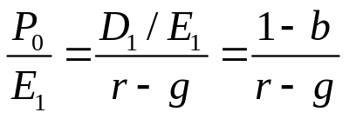
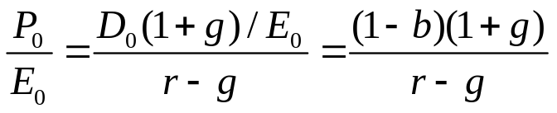
Justified P/E in a DCF model
DCF valuation models can be used to develop an estimate of the justified P/E for a stock.
  In the Gordon growth form of the dividend discount model, the P/E is calculated using these two expressions (from chapter 2)
  The leading P/E is:
  The trailing P/E is:
Both expressions state P/E as a function of two fundamentals: the stock’s required rate of return, r, reflecting its risk, and the expected (stable) dividend growth rate, g. The dividend payout ratio, 1 – b, also enters into the expression. The stock’s justified P/E based on forecasted fundamentals.

Slide 18
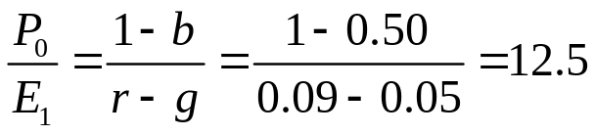
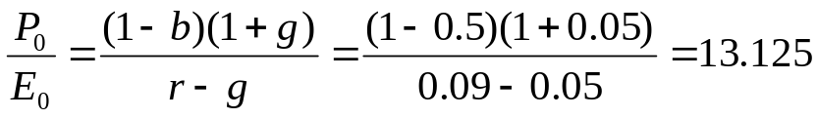
Justified P/E example
For FPL Group, Inc. (FPL), a utility analyst, forecasts a long-term payout rate of 50 percent, a long-term growth rate of 5 percent, and a required rate of return of 9 percent. Based upon these forecasts of fundamentals, what is FPL’s justified leading P/E and trailing P/E?
Leading justified P/E is:
Trailing justified P/E is:

Slide 19
Benchmark P/E’s
The choices for the benchmark value of the P/E that have appeared in practice include
The P/E of the most closely matched individual stock.
The average or median value of the P/E for the company’s peer group of companies within an industry.
The average or median value of the P/E for the company’s industry or sector.
The P/E for a representative equity index
An average past value of the P/E for the stock.
Valuation errors are probably less likely when we use an equity index or a group of stocks than when we use a single stock, because the former choices involve an averaging.

Slide 20
PEG ratios
One metric that appears to address the impact of earnings growth on P/E ratios is P/E to growth (PEG) ratio. The PEG ratio is calculated as the stock’s P/E divided by the expected earnings growth rate. The ratio in effect calculates a stock’s P/E per unit of expected growth. Stocks with lower PEGs are more attractive than stocks with higher PEGs, all else equal.
The PEG ratio is useful, but must be used with care for several reasons:
  The ratio assumes a linear relationship between P/E ratios and growth. The model for P/E in terms of DDM shows that in theory the relationship is not linear.
  The ratio does not factor in differences in risk, a very important component of P/E ratios.
  The ratio does not account for differences in the duration of growth. For example, dividing P/E ratios by short-term (5 year) growth forecasts may not capture differences in growth in long-term growth prospects.

Slide 21
The Fed Model
The Federal Reserve Board uses one such valuation model that relates the inverse of the S&P 500 P/E, the earnings yield, to the yield to maturity on 10-year Treasury Bonds. Earnings yield = E/P, where the Fed uses expected earnings for the next 12 months.
The Fed’s model asserts that the market is overvalued when the stock market’s current earnings yield is less than the 10-year Treasury bond yield. The intuition is that when Treasury bonds yield more than the earnings yield on the stock market, which is riskier than bonds, stocks are an unattractive investment.

Slide 22
Price to Book Value approach
In the P/E ratio, the measure of value, EPS, is a flow variable relating to the income statement. By contrast, the measure of value in the P/B ratio, book value per share, is a stock or level variable coming from the balance sheet.
Intuitively, book value per share attempts to represent the investment that common shareholders have made in the company, on a per-share basis.

Slide 23
Rationales for use of P/B ratio
Because book value is a cumulative balance sheet amount, book value is generally positive even when EPS is negative. We can generally use P/B when EPS is negative, whereas P/E based on a negative EPS is not meaningful.
Because book value per share is more stable than EPS, P/B may be more meaningful than P/E when EPS are abnormally high or low, or are highly variable.
As a measure of net asset value per share, book value per share has been viewed as appropriate for valuing companies composed chiefly of liquid assets, such as finance, investment, insurance, and banking institutions. For such companies, book values of assets may approximate market values.
Book value has also been used in valuation of companies that are not expected to continue as a going concern.
Differences in P/B ratios may be related to differences in long-run average returns, according to empirical research.

Slide 24
Possible drawbacks to P/B ratios
Other assets besides those recognized in accounting may be critical operating factors. For example, in many service companies human is more important than physical capital as an operating factor.
P/B can be misleading as a valuation indicator when there are significant differences among the level of assets employed by companies.
Accounting effects on book value may compromise book value as a measure of shareholders’ investment in the company. As one example, book value can understate shareholders’ investment as a result of the expensing of investment in research and development (R&D). Such expenditures often positively affect income over many periods and in principle create assets.
In the accounting of most countries, including the United States, book value largely reflects the historical purchase costs of assets, as well as accumulated accounting depreciation expenses. Inflation as well as technological change eventually drive a wedge between the book value and the market value of assets. As a result, book value per share often poorly reflects the value of shareholders’ investments.

Slide 25
Computation of book value
The computation of book value is as follows:
(Shareholders’ equity) minus (the total value of equity claims that are senior to common stock) = Common shareholders’ equity
(Common shareholders’ equity)/(number of common stock shares outstanding) = book value per share
Possible senior claims to common stock include the value of preferred stock and dividends in arrears on preferred stock.

Slide 26
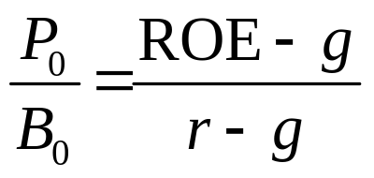
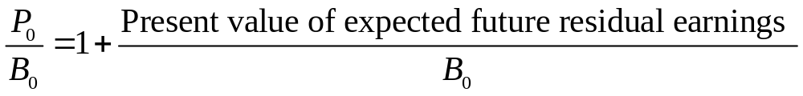
Justified P/B ratio
We can use fundamental forecasts to estimate a stock’s justified P/B ratio. For example, assuming the Gordon growth model and using the expression g = b × ROE for the sustainable growth rate, the expression for the justified P/B ratio based on the most recent book value (B₀) is
For example, if a business’s ROE is 12 percent, its required rate of return is 10 percent, and its expected growth rate is 7 percent, then its justified P/B based on fundamentals is (0.12 − 0.07)/(0.10 − 0.07) = 1.7.
Further insight into the P/B ratio comes from the residual income model. The expression for the justified P/B ratio based on the residual income valuation is:

Slide 27
Rationales for Price/Sales ratios
Sales are generally less subject to distortion or manipulation than other fundamentals such as EPS or book value. Through discretionary accounting decisions concerning expenses, for example, management can distort EPS as a reflection of economic performance. In contrast, total sales, as the top line in the income statement, is prior to any expenses.
Sales are positive even when EPS is negative. Therefore, we can use P/S when EPS is negative, whereas P/E based on a negative EPS is not meaningful.
Because sales are generally more stable than EPS, which reflects operating and financial leverage, P/S is generally more stable than P/E. P/S may be more meaningful than P/E when EPS is abnormally high or low.
P/S has been viewed as appropriate for valuing the stock of mature, cyclical, and zero income companies.
Differences in P/S ratios may be related to differences in long-run average returns, according to empirical research.

Slide 28
Drawbacks to P/S ratios
A business may show high growth in sales, although the business is not operating profitably as judged by earnings and cash flow from operations. To have value as a going concern, a business must ultimately generate earnings and cash.
The P/S ratio does not reflect differences in cost structures across companies.
Although relatively robust with respect to manipulation, there is potential through revenue recognition practices to distort the P/S ratio.

Slide 29
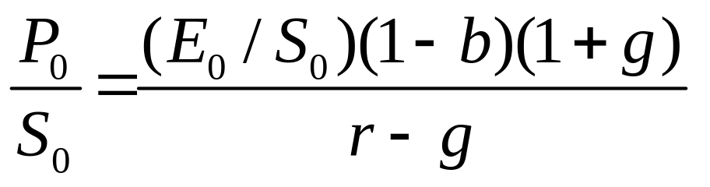
Justified P/S ratio
Like other multiples, the P/S multiple can be linked to DCF models. In terms of the Gordon growth model, we can state P/S as

Slide 30
Rationales for Price/Cash flow ratios
Cash flow is less subject to manipulation by management than earnings. Cash flow from operations, precisely defined, can be manipulated only through “real” activities, such as the sale of receivables.
Because cash flow is generally more stable than earnings, price-to-cash flow is generally more stable than P/E.
Using price to cash flow rather than P/E addresses the issue of differences in accounting conservatism between companies (differences in the quality of earnings).
Differences in price to cash flow may be related to differences in long-run average returns, according to empirical research.

Slide 31
Drawbacks to Price/Cash flow ratios
When the EPS plus non-cash charges approximation to cash flow from operations is used, items affecting actual cash flow from operations such as non-cash revenue and net changes in working capital are ignored.
Theory views free cash flow rather than cash flow as the appropriate variable for valuation. We can use P/FCFE ratios but FCFE has the possible drawback of being more volatile compared to CF for many businesses. FCFE is also more frequently negative than CF.

Slide 32
Four common cash flow measures
In practice, analysts and vendors of data often use simple approximations to cash flow from operations in calculating cash flow in price-to-cash flow.
A representative approximation specifies cash flow per share as EPS plus per-share depreciation, amortization, and depletion. We call this the earnings-plus-non-cash charges definition and use the symbol CF for it. We will also introduce more technically accurate cash flow concepts:
cash flow from operations (CFO)
free cash flow to equity (FCFE), and
EBITDA, an estimate of pre-interest, pre-tax operating cash flow.
Most frequently, trailing price-to-cash flow ratios are reported. A trailing price-to-cash flow ratio is calculated as the current market price divided by the sum of the most recent four quarters’ cash flow per share. A fiscal year definition is also possible, just as in the case of EPS.

